Slide 1

Predicting Temperature Trends in Tahoe
Sid, Joan, Teja, Alex
DATASCI 207, Summer 2024
Instructor: John Santerre PhD

Slide 2
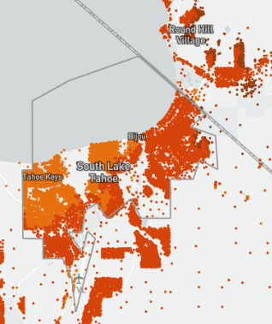
Background
Research and Environmental Monitoring
Wildfires
Public Safety
Economic Impact
Transportation
Agriculture
Recreation
Energy

Slide 3


Data Set
National Centers for Environmental Information Global Climate Database
Global Forest Watch Data Set
Processing Steps:
Data Wrangling
Assessing yearly averages for deforestation
Data normalization
Merging Datasets
Split data
Notes:
Speaker: Joan

Slide 4

Problem Statement
Developing Machine Learning models to accurately predict the average temperature in Tahoe using the NCEI's historical climate data and meteorological factors, with the aim of improving public safety, and supporting economic and environmental planning
Notes:
Speaker: Joan

Slide 5
Baseline models
Baseline takes in features without a time component to predict `tavg`
Models evaluated: linear regression, neural network regression, and XGBoost regressor
Notes:
Speaker: Alex
Our baseline models took in cleaned features to to predict average temperature. Three models served as our level-setting: linear regression, neural network regression, and XGBoost regressor.

Slide 6
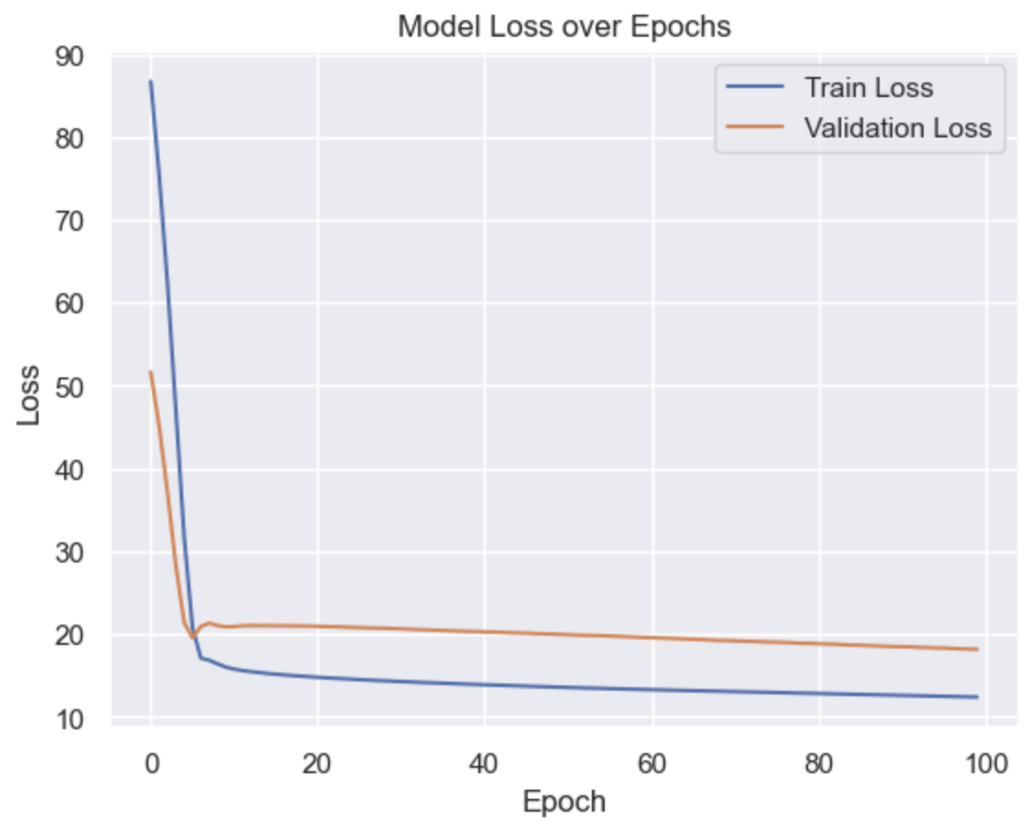
Baseline loss and RSME
Neural Net
Model Type | Loss
Linear Regression | RSME: 4.7482
Neural net regression | RSME: 3.992
XGBoost regressor | RSME: 3.0593
Notes:
Speaker: Alex
Our neural net had 2 hidden layers, with ‘relu’ for activation, which showed a step lower in loss than linear regression, but with the validation loss plateauing, the training data may be overfitting.
XGBoost regressor proved to be a bit better in performance, but still not a large enough change.

Slide 7
Time Series using ARIMA
AR
Autoregressive: forecasting future values using a linear combination of previously observed values
I
Integrated: the number of differencing required to make time series stationary (where the time series has constant variance and mean)
MA
Moving Average: forecasting using past errors instead of actual observed values
Notes:
Speaker: Joan

Slide 8
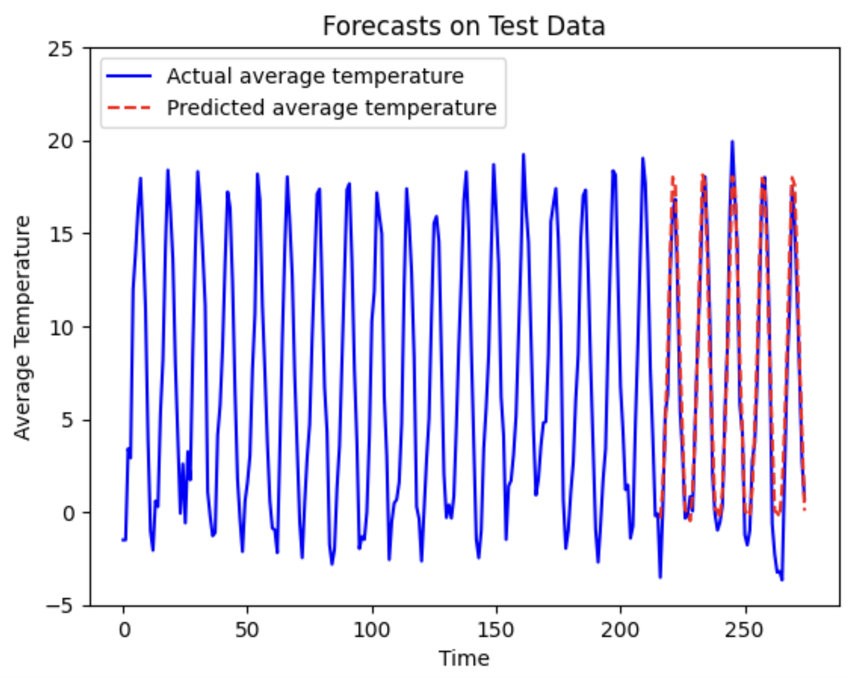
Time Series using ARIMA Loss 1.720
Notes:
Speaker: Joan

Slide 9
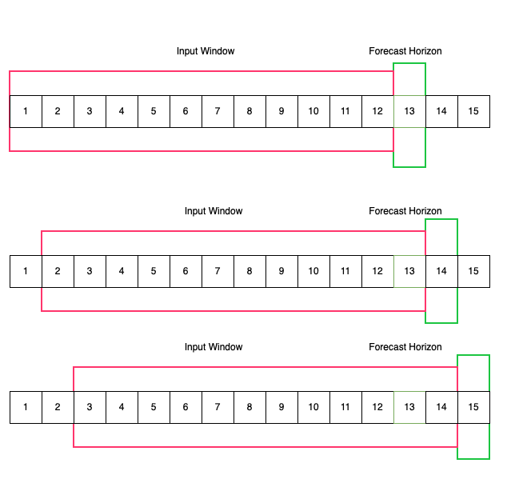
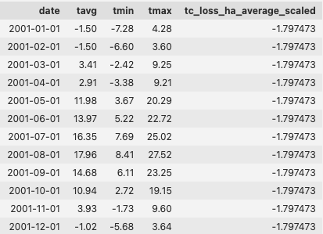
Time Series using Neural Networks
Features (X)
Label (y) == TAVG
Notes:
Speaker: Sid
Thank you Joan! The next model we built was, obviously, a deep neural network!
First, we used the sliding window technique to convert our time series problem into a supervised learning problem. We did this by creating sequences using the test data.
During model training, the input window shown in red above, becomes the X_train and the value in the forecast horizon, in the green box is the label or the y_train.
We chose a window size of 12, which corresponds to 12 months, i.e. a full year. Our model learns to predict the next average temperature using the data of the previous 12 months.
The input window of 12 months helps our model learn the seasonality aspect of the data. By adding other variables into our X_train, our problem becomes what’s called multi-variate time series problem, with features like Minimum Temperature, Maximum Temperature as well as annual Tree Cover loss taken from the Global Forest Cover database, which we normalized using a Standard Scaler.

Slide 10
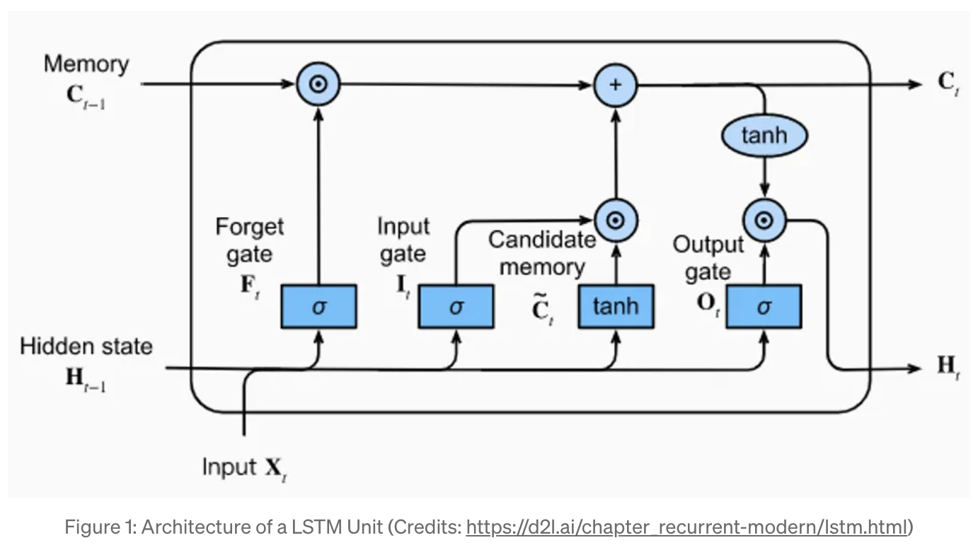
Sliding with LSTM
Long Term Trends from LSTM Memory
Short Term Trends from Hidden State
Notes:
Speaker: Sid
We chose to use LSTM cells in our neural network to learn temporal dynamics and trends due to their ability to remember information across varying time intervals. LSTM abbreviates Long Short Term Memory networks, are a type of recurrent neural network (RNN), are known for their effectiveness in retaining both short-term and long-term information.
This is helpful as they can capture and utilize data from recently preceding months as well as trends from longer periods, such as the weather from the same month of the previous year, making them ideal for our time series analysis.
The arrows here illustrate our LSTM nodes possibly learning the short term trends using the Memory of LSTM, indicated by the Orange line while the recent trends are captured by the light blue line.

Slide 11
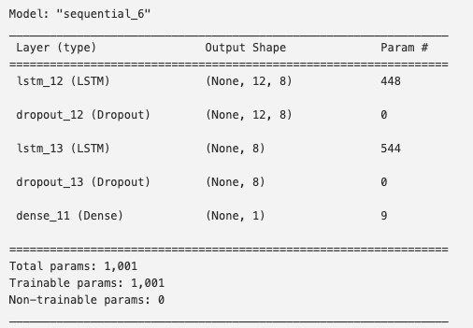
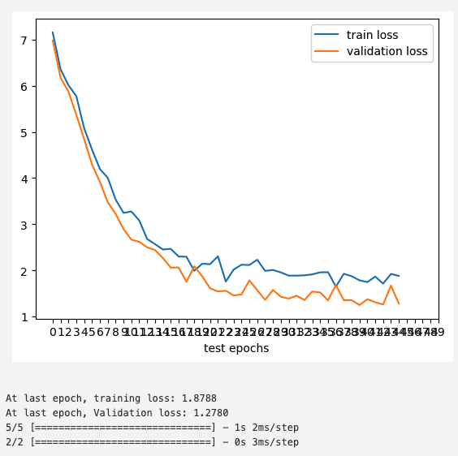
Neural Network using LSTM
Notes:
Speaker: Sid
Since our training dataset was small, we didn’t have the liberty to add too many LSTM cells or hidden layers. Given the constraints, we ended up picking 2 LSTM layers of size 8 cells each, followed by Dropout layers which help in generalization. In the end, we had a dense layer serving as the output layer.
We tried building various models, using relevant variables like minimum temperature, maximum temperature as well as yearly data from the Global Forest Database and we were able to get the best results by adding the Tree Cover Loss Average across the globe, after normalizing them.
We had to do hyper-parameter tuning to reach a sufficiently acceptable loss curve. Our training does do a little overfitting given the small training set but not by much.

Slide 12
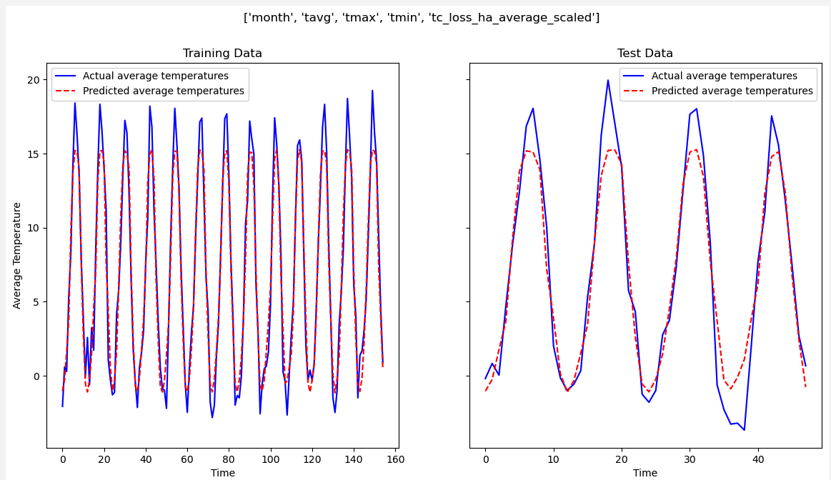

Training and Evaluation
Notes:
Speaker: Sid
Using our best RNN model, as you can see with the figure on the right, our model can fairly predict the seasonality of the average temperatures. It also predicts the temperature ranges well.
The steep lows and highs in the actual data are not captured by the model as they are too difficult to predict and depend on various other factors not covered by our model. These can can be considered the error.
That’s all for our Neural network model. Now I’ll pass it on to my colleague Alex for final analysis of our models.

Slide 13
Comparing All Models
Model Type | Loss
Linear Regression (Base) | RSME: 4.748
Neural net regression (Base) | RSME: 3.992
XGBoost regressor (Base) | RSME: 3.059
ARIMA | RMSE: 1.720
LSTM | RMSE: 1.536
Notes:
Speaker:
Among the various models we explored, our LSTM-based model produced the best results, closely followed by the ARIMA model, a well-established workhorse for time series data. While our models predict seasonal trends and ranges effectively, they struggle to capture the sharp peaks and troughs in the actual data, as these extremes are particularly challenging to forecast.

Slide 14
Limitations and Conclusion
Limited NCEI data
The Global Forest Data had only a yearly forest cover loss granularity.
Complexity of Weather Predictions
Model only accounts for one region
Expand Data Sources, Broaden Geographic Scope, Incorporate Additional Features, Collaborate with Experts
Notes:
Speaker: Alex
Despite the performance changes in our models, our data sets had some key limiting factors: small sample size and only an annual value for forest cover loss.
Ian Malcom and nonlinear dynamics

